Slide 1
V-Model Presentation
Presentation for the class of ESOF
T2 - Software Processes

Slide 2

What Is The V-Model?

Slide 3
What Is The V-Model?
V-Model is a strict model for software development developed as an extension from the Waterfall model
It can be summarized by its shape, a V:
  The left side has the verification stages
  The right side is comprised of the validation stages
  At the point where both sides meet, at the bottom of the V, code is developed and implemented

Slide 4
Origin of the V-Model
The V-Model, or Vee Model, was created by the German government in the 1990s to manage project development in their defence department.
It was developed as a counter-part to the PRINCE2 model, and is to this day still used by the UK and USA’s governments.

Slide 5
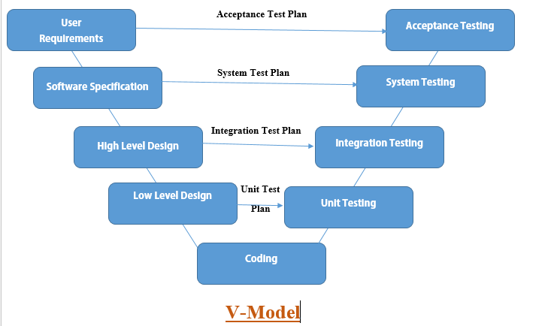
The Stages

Slide 6
The Stages – Left Side (Verification Stages)
User Requirements – Where the user’s needs and respective solutions are determined
System Design – Where the techniques and methods that will be needed to accomplish the solutions are decided
Architecture Design – Where the high-level concepts for the code are designed, making use of tools such as class diagrams
Module Design – Where the functions to be developed in the implementation stage are defined

